Slide 1
Module II
Sensors and Actuators: Sensor classification- touch, force, proximity, vision sensors. Internal sensors-Position sensors, velocity sensors, acceleration sensors, Force sensors; External sensors-contact type, noncontact type; Vision - Elements of vision sensor, image acquisition, image processing; Selection of sensors.
Actuators for robots- classification-Electric, Hydraulic, Pneumatic actuators; their advantages and disadvantages; Electric actuators- Stepper motors, DC motors, DC servo motors and their drivers, AC motors, Linear actuators, selection of motors; Hydraulic actuators- Components and typical circuit, advantages and disadvantages; Pneumatic Actuators- Components and typical circuit, advantages and disadvantages

Slide 2
Sensors
The sensor is a physical device, that senses a physical quantity and then converts it into signals which can be read by an instrument or the user.
A TRANSDUCER is a device, which transforms energy from one form to another.
Sensor and transducer are used interchangeably to denote a sensor transducer unit.

Slide 3
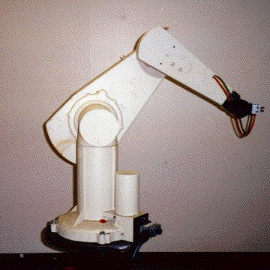
Why do robots need sensors?

Slide 4
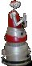
Why do robots need sensors?

Slide 5

Why do robots need sensors?
Obstacle Detection

Slide 6
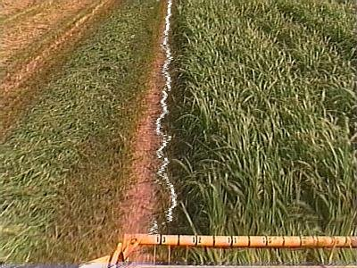

Sensing for specific tasks

Slide 7

Sensing for specific tasks

Slide 8
Other Functions of Robotic Sensors
Safe Operation : Protection of human workers who work in vicinity of the Robot.
Interlocking : This is required to coordinate the sequence of operations on a component. For eg: Unless turning is done on a component ,it should not be transferred to the conveyor.
Inspection: It is essential for quality control. Eg is the use of vision system to measure the length of a component to check whether it is within acceptable tolerance or not.
Part Configuration: If a robot is used to weld 2 parts of a car body, the sensors must identify the correct configurations ie position and orientation of the parts, before welding.

Slide 9
Sensors and Actuators
Sensors in robot is like our nose, ears, mouth and skin, whereas vision or robot vision is like our eyes.
Robots like human must gather extensive information about their environment in order to function effectively.
As the robotic arm moves in a 3 dimensional space it must avoid obstacles and approach items to be handles at a controlled speed.
Major capabilities required by robots are:
Simple touch (Presence of absence of a object),
Taction or Complex touch (information on shape and size of object),
Simple force(measure of force on single axis),
Complex force (measure of force on two or more axis),
Proximity (Noncontact detection of object),
Simple vision (detect edges, corners etc),
Complex vision (Recognize shape)

Slide 10
Sensor Classification
Based on the type of signals: Analog or Digital sensor
In analog sensors, with the variation of input there is a continuous variation of output, whereas in case of digital sensors, the output is of digital or discrete nature.
Potentiometers, tacho-generators located at the joints and strain-gauge-based sensors located at the end-effector of a robot fall in the category of analog sensors, whereas encoders, located at the robot's joints, are digital sensors.

Slide 11
Sensor Classification
Based on what they sense: Internal or external sensor
Internal Sensors
They are used to measure the internal state of a robot ie Position, Velocity, Acceleration etc.
Depending on the quantities it measures , a sensor is termed as position , velocity , acceleration or force sensor.
External Sensors
External Sensors are used to learn about Robot’s environment.
They can be classified as Contact type and non contact type sensors.

Slide 12
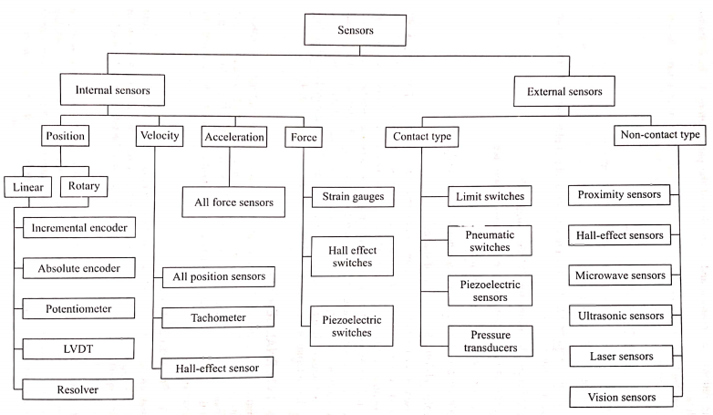
Sensor Classification

Slide 13
Internal Sensors - Position Sensors
Position sensors measure the position of each point.
End effector position and orientation can be found using different position sensors.
Linear Encoder
Rotary Encoder
Potentiometer
LVDT
Resolver

Slide 14
Encoder
Digital optical device that converts motion in to a sequence of digital pulses. By counting a single bit or by decoding a set of bits ,the pulses can be converted to relative or absolute measurements.
Encoders are of 2 types
Incremental type
Absolute type
Linear
Rotary
Linear
Rotary

Slide 15
Linear and Rotary Encoders
The Linear Encoder uses a transducer to measure the distance between two points. These encoders can use a rod or a cable that is run between the encoder transducer and the object that will be measured for movement.
A Rotary Encoder collects data and provides feedback based on the rotation of an object or in other words, a rotating device. Rotary Encoders are sometimes called “Shaft Encoders”. This encoder type can convert an object’s angular position or motion based on the rotation of the shaft, depending on the measurement type used.

Slide 16
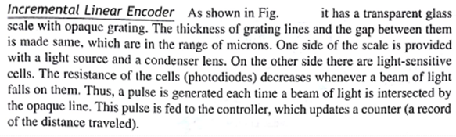
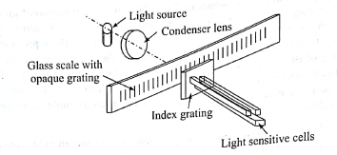
Incremental linear Encoder

Slide 17
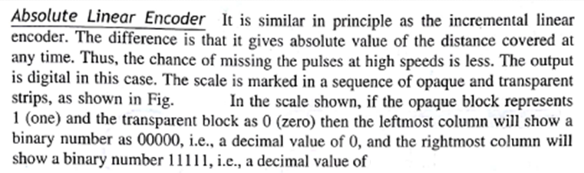
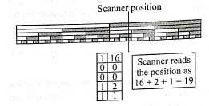
31

Slide 18
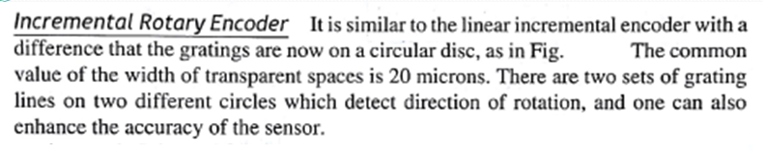
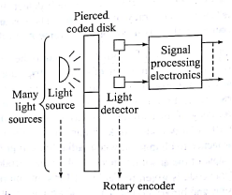
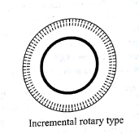
There is another circle, which contains only one grating mark. It is used for measurement of full circles.

Slide 19
Incremental Rotary encoder
https://www.youtube.com/watch?v=7St8rsvYTTU

Slide 20
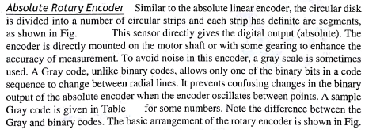
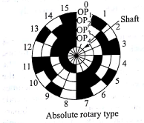
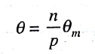
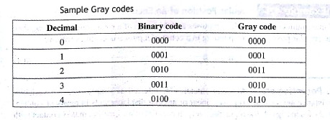

Slide 21
Absolute Encoders
https://www.youtube.com/watch?v=CHE1imH9tdg

Slide 22
Encoders Retrospection
https://www.youtube.com/watch?v=qT6FdvcEsMs

Slide 23
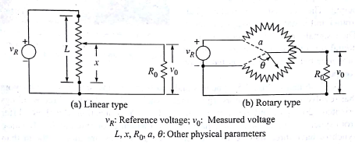
Potentiometer
Potentiometers work by varying the position of a sliding contact across a uniform resistance. In a potentiometer, the entire input voltage is applied across the whole length of the resistor, and the output voltage is the voltage drop between the fixed and sliding contact as shown below.

Slide 24
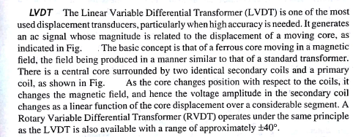
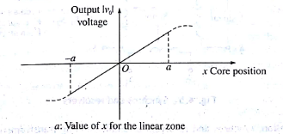
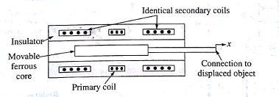

Slide 25
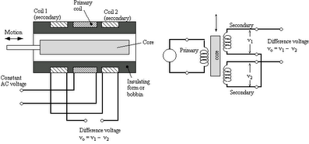
LVDT

Slide 26
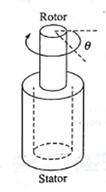
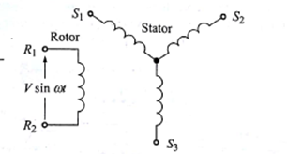
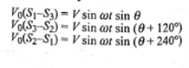
Synchros and Resolvers
A synchro is essentially a transformer whose primary-to-secondary coupling may be varied by physically changing the relative orientation of the two windings. This in turn varies the magnitude of the output voltage. In some systems, a mechanical input, such as a shaft rotation, is converted to a unique set of output voltages.
It consists of a rotating shaft (rotor)and a stationary housing(stator).The primary or input winding is usually the rotor, with the stator as the secondary or output element. The rotor is excited through a pair of slip rings with an AC voltage. The field produced by this voltage induces a voltage into each of the stator phases. The magnitude of the induced voltage depends on the angle between the rotor fields and the resultant axis of the coils forming that stator phase. Since the axes of the three stator phases are 120° apart, the magnitudes of the stator output voltages can be written as:

Slide 27
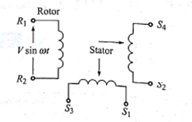
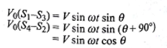
Resolvers are similar, but they have two stator coils at a 90° orientation rather than the 120° configuration of the synchro. The output signal amplitudes vary with the sine and cosine of the rotation angle, as the inductive coupling between rotor and stator coils varies with the angular position of the rotor.

Slide 28
Resolver
https://www.youtube.com/watch?v=7X7KBtx3D7o
https://www.youtube.com/watch?v=7PKJ52b1Qvs

Slide 29
Internal Sensors - Velocity Sensors
Velocity or speed sensors measure by taking consecutive position measurements at known time intervals and computing the time rate of change of the position values or directly finding it based on different principles.
Position Sensors Basically, all position sensors when used within certain time bounds can give velocity, e.g., the number of pulses given by an incremental position encoder divided by the time consumed in doing so. But this scheme puts some computational load on the controller which may be busy in some other computations.
The following sensors can directly find the velocity at any instant of time, and without much of computational load.
Tachometers
Hall Effect Sensors

Slide 30
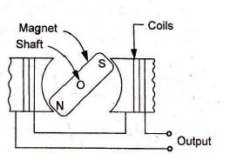
Tachometers
This measures the speed of rotation of an element.
There are various types of tachometers in use but a simpler design is based on the Fleming’s rule, which states ‘the voltage produced is proportional to the rate of flux linkage.’
It possess primary and secondary stators with
fixed windings and a rotor with permanent
magnet.
The rotor is attached to shaft of the motor.
If the rotor is stationary, a constant output
voltage will be obtained.
If the rotor is moving, output voltage proportional to speed of rotor is obtained.
This information is digitized using an analog-to-digital converter and passed on to the computer.

Slide 31
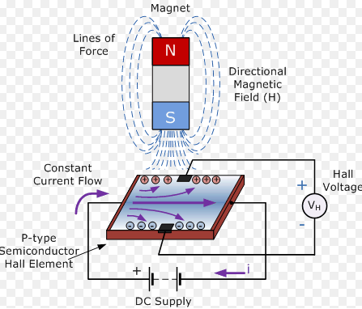
Hall Effect Sensors
Hall Effect : On a thin strip of a conductor, electrons flow in a straight line when electricity is applied. When this charged conductor comes in contact with the magnetic field which is in a perpendicular direction to the motion of electrons, the electrons get deflected. Some electrons get collected on one side while some on another side. Due to this, one of the conductor’s plane behaves as negatively charged while the other behaves as positively charged. This creates potential difference and voltage is generated. This voltage is called the Hall voltage. Higher the magnetic field value, higher the voltage level. If one provides a ring magnet, the voltage produced is proportional to the speed of rotation of the magnet.
https://www.youtube.com/watch?v=wpAA3qeOYiI

Slide 32
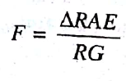
Internal Sensors - Acceleration Sensors
Acceleration can be found as the time rate of change of velocities obtained from velocity sensors. But this will put heavy computational load on the computer and can affect the speed of operation of the system.
An alternate method to find acceleration is to measure the force which is the result of mass times acceleration.
For eg: forces are measured using strain gauges for which the formula is
Where F is the force , ∆R is the change in resistance , A is the cross sectional area on which the force is applied , E is the modulus of elasticity of strain gauge material, R is the original resistance and G is the gauge factor. Then acceleration a is given by
A = F/m = ∆RAE/RGm

Slide 33
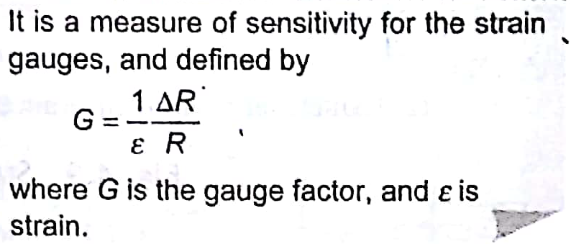
Gauge Factor

Slide 34
Internal Sensors - Force Sensors
A Force Sensor is a sensor that helps in measuring the amount of force applied to an object.
A spring balance is an example of a force sensor in which a force, namely, the weight, is applied to the scale pan that causes displacement, i.e., the spring stretches. The displacement is then a measure of the force. There exist other types of force sensors
Strain Gauge based force sensor
Piezoelectric based
Current based

Slide 35
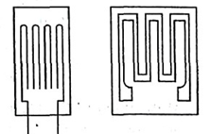
Strain Gauge based force sensor
The principle of this type of sensors is that the elongation of a conductor increases its resistance. Typical resistances for strain gauges are 50-100 ohms. The increase in resistance is due to
Increase in the length of the conductor; and Decrease in the cross-section area of the conductor.
Strain gauges are made of electrical conductors, usually wire or foil, etched on a base material, as shown in Fig. They are glued on the surfaces where strains are to be measured.
The strains cause changes in the resistances of the strain gauges, which are measured by attaching them to the Wheatstone bridge circuit as one of the four resistances.

Slide 36
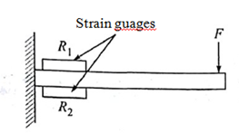
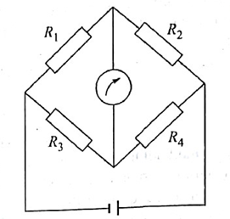
Strain Gauge based force sensor
In order to enhance the output voltage and cancel away the resistance changes due to the change in temperature, two strain gauges are used, as shown in Fig, to measure the force at the end of the cantilever beam.
Cantilever beam with strain gauge
Wheatstone’s bridge circuit

Slide 37
Piezoelectric based force sensor
A piezoelectric sensor is a device that uses the piezoelectric effect to measure changes in pressure, acceleration, temperature, strain, or force by converting them to an electrical charge.
Piezoelectric Effect is the ability of certain materials to generate an electric charge in response to applied mechanical stress. The word Piezoelectric is derived from the Greek “piezein” which means to squeeze or press, and “piezo”, which is Greek for “push”.
When piezoelectric material is placed under mechanical stress, a shifting of the positive and negative charge centers in the material takes place, which then results in an external electrical field. When reversed, an outer electrical field either stretches or compresses the piezoelectric material.
Some naturally piezoelectric occurring materials include Berlinite (structurally identical to quartz), cane sugar, quartz, Rochelle salt, topaz and tourmaline.

Slide 38
Current based force sensor
The torque provided by an electric motor is a function of the current drawn.
Hence the measure of this current along with the known motor characteristics gives the torque sensing.

Slide 39
Tutorial
For a strain gauge, if gauge factor G=2 ,resistance R = 100Ω and € = 10⁻⁶ then Compute the change in resistance.
2. If strain gauge with € = 0.1 is used to measure applied force, F on a member of cross sectional area, A =10m² , and Young’s Modulus E = 6.9 *10⁻¹⁰N/m², then Find the force F and hence find acceleration a ,if m = 3kg.

Slide 40
External Sensors
They are primarily used to learn more about a robot’s environment, especially the objects being manipulated.
External sensors can be divided into
Contact type
Non contact type

Slide 41
Contact type
Limit Switch:
It is used to convert mechanical motion into an electrical signal to switch circuits.
It is an electromechanical device that consists of a mechanical actuator linked to a series of electrical contacts.
When an object comes in physical contact with the actuator , it tends to move and this movement is used to open or close an electric switch.

Slide 42
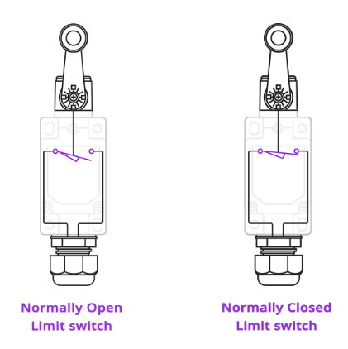
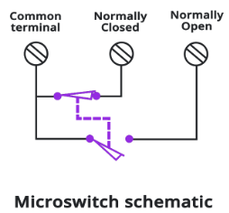
Contact type
Limit switches can be either Normally Open (NO) or Normally Closed (NC) and may have multiple-poles.

Slide 43
Contact Type
Limit switches are mechanical devices which have problems like:
They are subjected to mechanical failure,
The speed of operation is relatively slow compared to the speed of switching of photoelectric micro-sensors which is up to 3000 times faster.
Limit switches are used in robots to detect the extreme positions of the motions, where the link reaching an extreme position switches off the corresponding actuator, thus, safeguarding any possible damage to the mechanical structure of the robot arm.

Slide 44
Noncontact Type
Proximity Sensor: Proximity sensing is the technique of detecting the presence or absence of an object with an electronic noncontact-type sensor.
Proximity sensors are of two types, inductive and capacitive.
Inductive proximity sensors are used in place of limit switches for noncontact sensing of metallic objects, whereas
Capacitive proximity sensors are used on the same basis as inductive proximity sensors. However, these can also detect nonmetallic objects

Slide 45
Inductive proximity sensors
It consist of four basic elements:
Sensor coil and ferrite core
Oscillator circuit
Detector circuit
Solid-state output circuit
The sensing range of an inductive proximity sensor refers to the distance between the sensor face and the target.
The usual range is up to 10-15 mm but some sensors have ranges as high as 100 mm.

Slide 46
Working
The oscillator circuit generates a radio-frequency electromagnetic field.
The field is centered around the axis of the ferrite core, which shapes the field and directs it at the sensor face.
When a metal target approaches the face and enters the field, eddy currents are induced into the surface of the target. This results in a loading or damping effect that causes a reduction in amplitude of the oscillator signal.

Slide 47
Working
The detector circuit detects the change in the oscillator amplitude. The detector circuit will 'switch on' at specific operating amplitude. This signal 'turns on' the solid-state output circuit. This is often referred to as damped condition.
As the target leaves the sensing field, the oscillator responds with an increase in amplitude. As the amplitude increases above a specific value, it is detected by the detector circuit, which is 'switched off' causing the output signal to return to the normal or 'off' state.

Slide 48
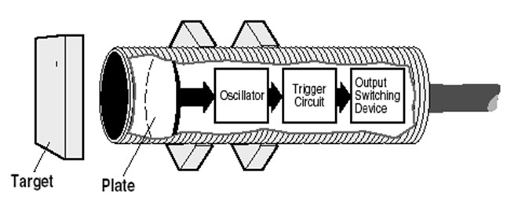
Capacitive Proximity Sensor
Capacitive Proximity Sensors detect changes in the capacitance between the sensing object and the Sensor.
An ordinary Capacitive Proximity Sensor is similar to a capacitor with two parallel plates,
One of the plates is the object being measured (with an imaginary ground), and the other is the Sensor’s sensing surface.

Slide 49
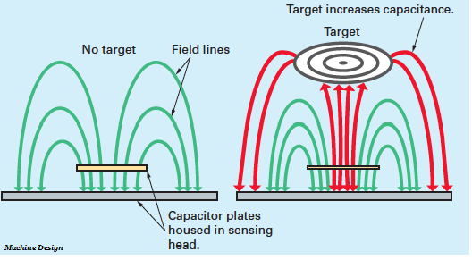
Parts & Working
The capacitive proximity sensor consist a high-frequency oscillator along with a sensing surface formed by two metal electrodes.
When an object comes near the sensing surface, it enters the electrostatic field of the electrodes and changes the capacitance of the oscillator.
As a result, the oscillator circuit starts oscillating and changes the output state of the sensor when it reaches certain amplitude. As the object moves away from the sensor, the oscillator’s amplitude decreases, switching the sensor back to its initial state.

Slide 50
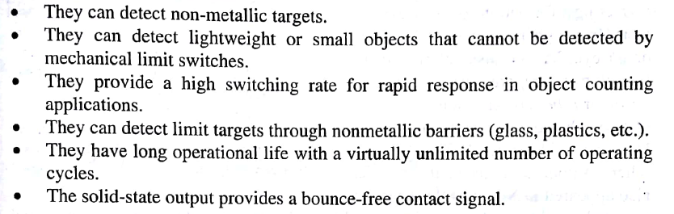
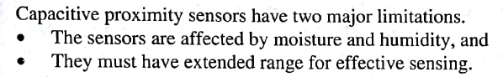
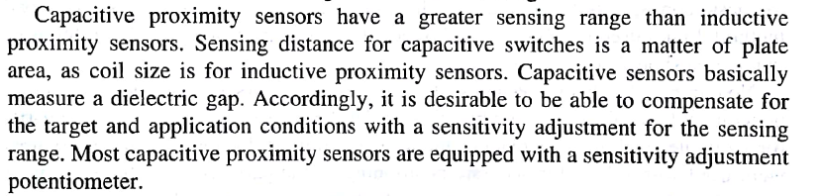
Characteristics of Capacitive type proximity sensor

Slide 51
Semiconductor displacement sensor

Slide 52
Working
Semiconductor displacement sensor uses a semiconductor light emitting diode(LED) or laser as a light source and a position sensitive detector(PSD).
The laser beam is focused by a lens to target. The target reflects the beam, which is then focused on to the PSD forming a beam spot.
The beam spot moves on the PSD as the target moves.
The displacement of the work piece can be determined by detecting the movement of the beam spot

Slide 53
Vision
Vision can be defined as the task of extracting information about the external world from light rays imaged by a camera or an eye.
Vision systems or Vision sensors are classified as an external noncontact type sensor.
The vision system enables a robot to see and identify various objects. The system provides the robot with an ability to collect the light reflected from the objects, process an image out of it and then perform the desired action.
The vision system helps with these functions by using various electronic devices and hardware systems.
Tasks of Vision systems used with Robots include
Inspection
Identification
Visual Servoing and Navigation Control

Slide 54
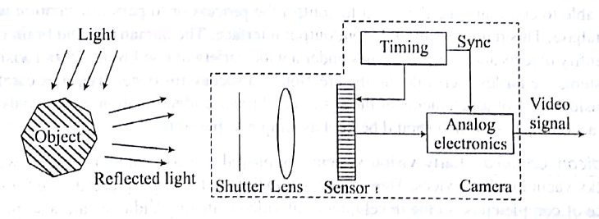
Elements of Vision sensor
In vision systems, the principal imaging component is a complete camera including sensing array, associated electronics, output signal format, and lens, as shown in the figure

Slide 55
Elements of Vision sensor- Assignment 2
Camera Systems:
Vidicon Camera
Digital Camera
Lighting Techniques
It illuminates the part to be viewed so that its features stand out allowing the camera to see clearly.
Direct incident lighting
Diffuse Incident lighting
Lateral lighting
Dark field lighting
Backlighting

Slide 56
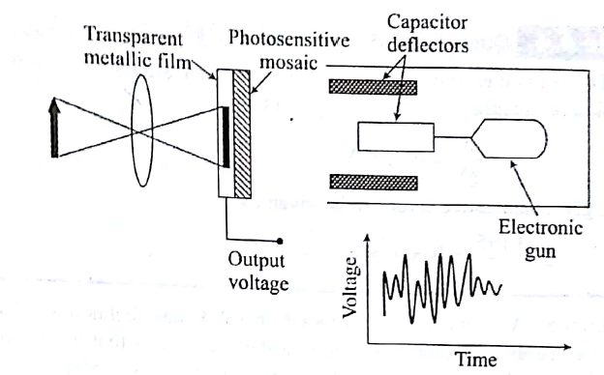
Vidicon Camera
The vidicon is a storage-type camera tube in which a charge-density pattern is formed by the imaged scene radiation on a photoconductive surface which is then scanned by a beam of low-velocity electrons.
The fluctuating voltage coupled out to a video amplifier can be used to reproduce the scene being imaged.

Slide 57
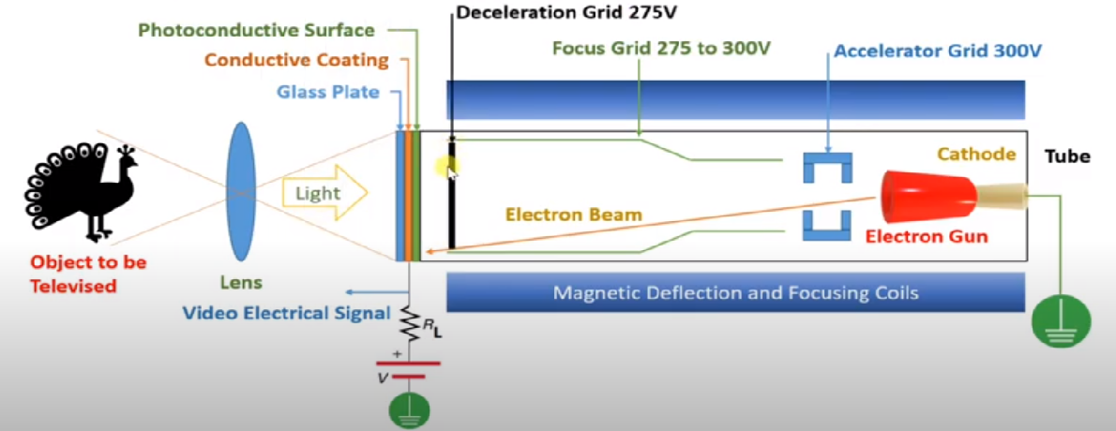
Working

Slide 58
Working
Photoconductivity is the basis of working of a Vidicon. We all know that photo means light and so photoconductivity is the property that shows the variation in conductivity of any material with the change in intensity of light falling on that surface.
The mosaic reacts to the varying intensity of a light by varying its resistance.
Now as the electric gun generates and sends a continuous cathode beam to the mosaic passing though two pairs of orthogonal capacitors (deflectors), the electron beam gets deflected up or down, and left or right based on the charge on each pair capacitors.
As the beam scans the image, at each instant, the output is proportional to the resistance of the mosaic or the light intensity on the mosaic.
By reading the output voltage continuously, an analog representation of the image can be obtained.
Analog signal of the vidicon has to be changed to digital signal using A to D convertors in order to process the image further using a PC.

Slide 59
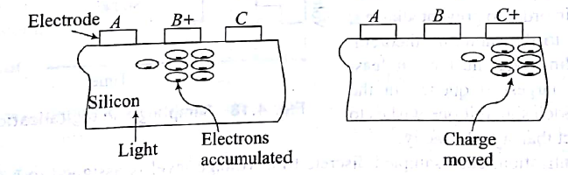
Digital Camera
A digital camera is based on solid-state technology.
The main part of these cameras is a solid-state silicon wafer image area that has hundreds of thousands of extremely small photosensitive areas called photosites printed on it.
Each small area of the wafer is a pixel contraction of picture element.
As the image is projected onto the image area, at each pixel location of the wafer, a charge is developed that is proportional to the intensity of the light at that location.
The charge that is generated is proportional to the number of photons that hit the sensor
Light from the thing you are photographing zooms into the camera lens. This incoming "picture" hits the image sensor chip, which breaks it up into millions of pixels. The sensor measures the color and brightness of each pixel and stores it as a number.

Slide 60
Digital Camera
Thus, a digital camera is also called a Charged Coupled Device (CCD) camera or Charge Integrated Device (CID) camera.
The collection of charges, as shown in Fig if read sequentially, would be a representation of the image pixels.
The output is a discrete representation of the image as a voltage sampled in time.
Solid- state cameras are smaller, more rugged, last longer, and have less inherent image distortion than vidicon cameras.

Slide 61
Camera working
https://www.youtube.com/watch?v=ED-KnFL_J7Y

Slide 62
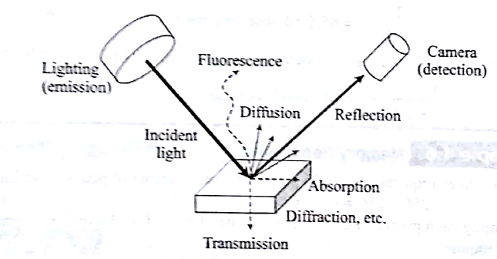
Lighting Techniques
Lighting is very important to machine vision as it illuminates the part to be viewed so that its features stand out allowing the camera to see clearly.
Different points on the objects in front of the imaging system will have different intensity values on the image, depending on the amount of incident radiance, how they are illuminated, how they reflect light , how reflected light is collected by the lens and how the sensor camera responds to the incoming light .Hence proper illumination is required.

Slide 63
Lighting Techniques
It must avoid reflections and shadow unless they are designed for the purpose of image processing.
The main purpose is to create contrast between the object features to be detected.
Typical lighting techniques are
Direct incident lighting
Diffuse Incident lighting
Lateral lighting
Dark field lighting
Backlighting

Slide 64
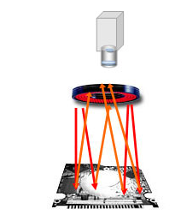
Direct incident lighting
Used for non reflective materials that strongly scatter the light due to their matte , porous, fibrous and nonglossy surface.
Ideally a ring light is chosen for smaller illuminated fields that can be arranged around the lens.
Shadows are avoided due to vertical illumination.
Advantages:
Direct incident light illuminations are inexpensive and do not require any complicated design.
All types of lighting such as halogen, fluorescent or LED lighting can be used.
Ideal to illuminate large areas.
Several lights can be combined, too.
Direct light is usually bright because of a directly radiating surface with low beam angle and strong reflection.

Slide 65
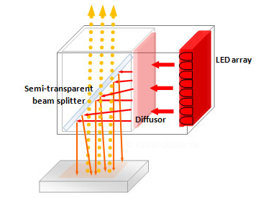
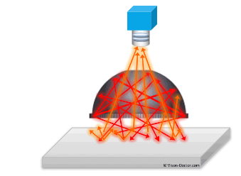
Diffuse Incident Lighting
Diffuse light is necessary for many applications, eg to test reflective, polished, glossy or metallic objects. It is particularly difficult if these surfaces are no longer perfectly flat, but individually shaped, wrinkled, curved or cylindrical.
To create diffused lighting ,one may use incident light with diffusers like
Coaxial illumination [ light is coupled into the axis of camera by means of beam splitter or half mirror]
Dome shaped illumination.[light is diffused by means of a diffused coated dome in which the camera looks through an opening in the dome on to the work piece]

Slide 66
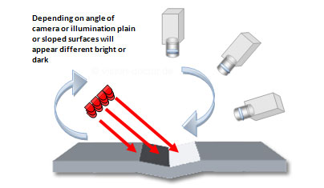
Lateral Lighting
Light from the side can be radiated at a relatively wide or narrow angle.
The influence on the camera image can be significant, in an extreme case the image information can almost be inverted.

Slide 67
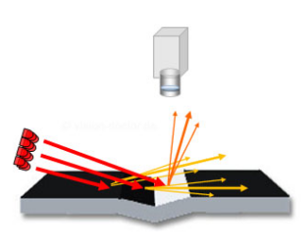
Dark field lighting
At a first sight, images captured using dark field illumination seem unusual to the viewer.
The light shines at a shallow angle. According to the principle "angle of incidence = angle of reflection", all the light is directed away from the viewer (the camera), the field of view therefore remains dark.
Inclined edges, scratches, imprints, slots, and elevations interfere with the beam of light. At these anomalies, the light is reflected towards the camera, or mostly only strayed. These defects appear bright in the camera image in this way.

Slide 68
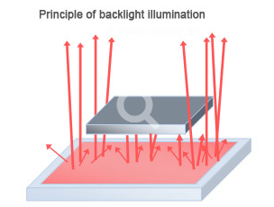
Backlighting
Transmitted light illumination is the first choice of lighting when it is necessary to measure parts as accurately as possible.
The lighting is arranged on the opposite side of the camera, the component itself is put in the light beam.
Assignment 2 ends here

Slide 69

Steps in Vision system
Vision has 2 steps
Image Acquisition and
Image Processing

Slide 70
Image Acquisition
In image acquisition, an image is acquired from a vidicon which is digitized or from a digital camera (CCD or CID).
The image is stored in computer memory (also called a frame buffer) in the format such as TIFF, JPG, Bitmap, etc. The buffer may be a part of the frame grabber card or in the computer itself.
The image acquisition is primarily a hardware function, however, software can be used to control light intensity, focus, camera angle, synchronization, field of view, read times, and other functions.
Image acquisition has four principle elements, namely,
A light source, either controlled or ambient,
A lens that focuses reflected light from the object on to the image sensor,
An image sensor that converts the light image into a stored electrical image, and
The electronics to read the sensed image from the image sensing element, and after processing, transmit the image information to a computer for further processing.

Slide 71


Image Acquisition
A typical acquired image is shown in Fig

Slide 72
Image storage and Retrieval
An image is generally acquired at the rate of 30 frames per second or each image stored in every 1/30 second.
If a vision system has a pixel density of 350 pixels per line and 280 lines, there will be a total of 350 x 280=98000 pixels.
Moreover, for a 6-bit register to represent various gray levels of a pixel, there is a requirement of storage of 98,000 x 6 = 588,000 bits of data, which is to be processed in every 1/30 second
For storage, a combination of row and column counters are used in the frame grabber.
To read the information stored in the frame buffer, the data is grabbed via a signal sent from the computer to the address corresponding to a row-column combination

Slide 73
Image Processing
Image processing techniques are used to enhance, improve, or otherwise alter an image and to prepare it for image analysis.
Usually, during image processing, information is not extracted from the image.
The intention is to remove faults, trivial information, or information that may be important, and to improve the image.
Image processing examines the digitized data to locate and recognize an object within the image field. It is divided into several sub-processes
Image Data Reduction
Histogram Analysis
Thresholding
Masking
Edge Detection
Segmentation and
Morphology Options

Slide 74
Image Data Reduction
The objective is to reduce the volume of data .
As a preliminary step in the data analysis, the schemes like digital conversion or windowing can be applied to reduce the data.
While the digital conversion reduces the number of gray levels used by the vision system, windowing involves using only a portion of the total image stored in the frame buffer for image processing and analysis. For example, in windowing, to inspect a circuit board, a rectangular window is selected to surround the component of interest and only pixels within that window are analyzed

Slide 75
Histogram Analysis
A histogram is a representation of the total number of pixels of an image at each gray level.
Histogram information is used in a number of different processes, including thresholding. For example, histogram information can help in determining a cut-off point when an image is to be transformed into binary values.
In digital image processing, histograms are used for simple calculations in software.
It is used to analyze an image. Properties of an image can be predicted by the detailed study of the histogram.
The brightness of the image can be adjusted by having the details of its histogram.
The contrast of the image can be adjusted according to the need by having details of the x-axis of a histogram.
It is used for image equalization. Gray level intensities are expanded along the x-axis to produce a high contrast image.
Histograms are used in thresholding as it improves the appearance of the image.
If we have input and output histogram of an image, we can determine which type of transformation is applied in the algorithm.

Slide 76
Thresholding
It is the process of dividing an image into different portions or levels by picking a certain grayness level as a threshold.
Comparing each pixel value with the threshold, and then assigning the pixel to the different portions or level depending on whether the pixel's grayness level is below the threshold ('off or 0, or not belonging) or above the threshold ('on' or 1, or belonging),

Slide 77
Masking
A mask may be used for many different purposes, e.g., filtering operations and noise reduction, and others.
It is possible to create masks that behave like a low pass filter such that higher frequencies of an image are attenuated while the lower frequencies are not changed very much.

Slide 78

Illustration of Masking
Masking an image considers a portion of an imaginary image shown in the fig(a) below, which has all the pixels at a gray value of 20 except the one at gray level of 100. The one with 100 may be considered noise.
Applying the 3 x 3 mask shown in Fig.(b) over the corner of the image yields the following value:

Slide 79

Illustration of Masking
The large difference between the noisy pixel and the surrounding pixels, ie, 100 vs. 20, becomes much smaller , namely, 29 vs. 20, thus reducing the noise. With this characteristic, the mask acts as a low pass filter. Note that the above reduction of noise has been achieved using what is referred as neighborhood averaging, which causes the reduction of the sharpness of the image as well.

Slide 80
Edge Detection
Edge detection is a general name for a class of computer programs and techniques that operate on an image and result in a line drawing of the image.
The lines represent changes in values such as cross section of planes, intersections of planes, textures, lines, etc
In many edge-detection techniques, the resulting edges are not continuous. However, in many applications, continuous edges are preferred, which can be obtained using the Hough transform. It is a technique used to determine the geometric relationship between different pixels on a line, including the slope of the line.

Slide 81

Hough Transform
Consider a straight line in the xy-plane, as shown in Fig
which is expressed as
y = mx + c
where m is the slope and c is the intercept. The line represented by Eq can be transformed into a Hough plane of m-c with x and y as its slope and intercept. respectively.
Thus, a line in the x-y plane with a particular slope and intercept will transform into a point in the Hough plane. For the Hough or m-c plane, if a line passes through (m1,c1), as shown in Fig. b, it represents a point (x ) in the y plane of Fig (a). In that way, all lines through a point in the Hough plane will transform into a single line in the x-y plane. Alternatively, if a group of points is collinear, their Hough transform will all intersect. By examining these properties in a particular case, it can be determined whether a cluster of pixels is on a straight line or not, whereupon the orientation of an object in a plane can be determined by calculating the orientation of a particular line in the object.
https://www.youtube.com/watch?v=5gik4qtNoNo

Slide 82


Hough Transform

Slide 83
Segmentation
Segmentation is a generic name for a number of different techniques that divide the image into segments of its constituents.
The purpose of segmentation is to separate the information contained in the image into smaller entities that can be used for other purposes.
Segmentation includes edge detection, region growing and splitting
Region growing works based on the similar attributes, such as gray-level ranges or other similarities, and then try to relate the regions by their average similarities.
Region splitting is carried out based on thresholding in which an image is split into closed areas of neighbourhood pixels by comparing them with thresholding value or range.

Slide 84


Morphology Operations
Morphology operations are a family of operations which are applied on the shape of subjects in an image.
They include many operations, both for binary and gray images, such as thickening, dilation, erosion, skeletonization, opening, closing, and filing.
These operations are performed on an image in order to aid in its analysis, as well as to reduce the 'extra' information that may be present in the image. For example, Fig.(a) shows the object which after skeletonization is shown in Fig.(b).

Slide 85
Actuators for robots
Actuators are used in order to produce mechanical movement in robots.
Actuators are the muscles of robots. There are many types of actuators available depending on the load involved. They are like the muscles of a human arm and hand.
Arm provides motion, whereas its gripper, which is equivalent to a human hand, manipulates objects.
Both require some kind of actuator system powered by electricity or compressed air or pressurized fluid.

Slide 86


Actuator System
An actuator system comprises of several subsystems, namely,
Power supply
Power amplifier
Servo motor, and
Transmission system,
The connections between all the actuator components are depicted in Fig

Slide 87
Actuators Classification
Based on the source of input power ,Pa, actuators can be classified as
Electric Actuators : The primary input power supply is the electric energy from the electric distribution system.
Hydraulic Actuators : They transform hydraulic energy stored in a reservoir to mechanical energy by means of suitable pumps.
Pneumatic Actuators They utilize pneumatic energy, i.e., compressed air provided by a compressor and transform it into mechanical energy by means of pistons or turbines.

Slide 88
Characteristics of Actuators in Robotic application
Low inertia
High power-to-weight ratio
Possibility of overload and delivery of impulse torques
Capacity to develop high accelerations
Wide velocity ranges
High positioning accuracy
Good trajectory tracking and positioning accuracy

Slide 89
Electric Actuators
Electric actuators are generally those where an electric motor drives robot links through some mechanical Transmission .
The first commercial electrically driven industrial robot was introduced in 1974 by ABB.

Slide 90
Advantages of Electric Motor
Widespread availability of power supply
Basic drive element in an electric motor is usually lighter than that for fluid power, ie pressurized fluid or compressed air
High power conversion efficiency.
No pollution of working environment
Accuracy and repeatability of electric drive robots are normally better than fluid power robots in relation to cost.
Being relatively quiet and clean, they are very acceptable environmentally.
They are easily maintained and repaired .
Structural components can be lightweight .
The drive system is well suited to electronic control

Slide 91
Disadvantages
Electrically driven robots often require the incorporation of some sort of mechanical transmission system.
Additional power is required to move the additional masses of the transmission system .
Unwanted movements due to backlash and plays in the transmission elements.
Due to the increased complexity with the transmission system, we need complex control requirement and additional cost for their procurement and maintenance.
Electric motors are not intrinsically safe, mainly, in explosive environments.

Slide 92
Types of electric motors
Stepper motor
DC motor
AC motor

Slide 93

Stepper motor
A stepper motor is an electric motor whose main feature is that its shaft rotates by performing steps, that is, by moving by a fixed amount of degrees.
These motors are widely used in other industrial applications mainly due to their advantage of not requiring any feedback system and, accordingly not incurring the associated cost. Because they are digitally controlled, they can be referred to as digital motors or actuators. These motors do not require the expense of digital to-analog conversion equipment when connected to a computer-control system.
As all with electric motors, stepper motors have a stationary part (the stator) and a moving part (the rotor). On the stator, there are teeth on which coils are wired, while the rotor is either a permanent magnet or a variable reluctance iron core.

Slide 94
Working Principle
The basic working principle of the stepper motor is electromagnetism.
By energizing one or more of the stator phases, a magnetic field is generated by the current flowing in the coil and the rotor aligns with this field.
By supplying different phases in sequence, the rotor can be rotated by a specific amount to reach the desired final position.

Slide 95

Working
At the beginning, coil A is energized and the rotor is aligned with the magnetic field it produces. When coil B is energized, the rotor rotates clockwise by 60° to align with the new magnetic field. The same happens when coil C is energized. In the pictures, the colors of the stator teeth indicate the direction of the magnetic field generated by the stator winding.

Slide 96


Normally, the shaft of a stepper motors rotates incrementally in equal steps in Response to a programmed input pulse train. As shown in Fig(a) current in any of the two phases, ie with P1 and P2 will magnetize the pair into north and south poles, indicted with N And S respectively
Accordingly, the permanent magnet at the centre will rotate in to align itself along a particular phase, which is demonstrated in Fig (b) Switching the currents in the two phases in an appropriate sequence can produce either clockwise (CW) or counterclockwise (CCW) rotations

Slide 97

The switching sequence of Table corresponds to what is known as half stepping with a step angle of 45°, whereas the full-stepping corresponds to 90 in which one phase is energized at a time.

Slide 98


Slide 99
Advantages and Disadvantages
Self study - HW

Slide 100
Stepper motor types
For a stepper motor, there are basically three types of rotors, based on which it is classified in to three
Permanent magnet stepper motor
Variable reluctance stepper motor
Hybrid stepper motor

Slide 101

Permanent magnet rotor
There are two coils A and B, each of them having four poles but displaced from each other by half a pole pitch. The rotor is of permanent magnet construction and has four poles. Each pole is wound with field winding, the coils on opposite pairs of poles being in series. Current is supplied from a dc source to the winding through switches. It can be seen in Fig.(a) that the motor is at rest with the poles of the permanent magnet rotor held between the residual poles of the stator. In this position, the rotor is locked unless a turning force is applied. If the coils are energized and, in the first pulse, the magnetic polarity of the poles of the coil A is reversed the rotor will experience a torque and will rotate counterclockwise, as shown in Fig. b. The reverse poles are shown as A.

Slide 102
Permanent magnet rotor
If the coil B poles are now reversed to B, as shown in Fig. c, the rotor will again experience a torque, and once more the poles of the rotor are positioned midway between the stator poles. Thus, by switching the currents through the coils, the rotor rotates by 45'. If in the first pulse, the poles of the coil B had been reversed then the motor would have rotated clockwise. With this type of motor, commonly produced step angles are 1.8 °,7.5 ° , 15 ° ,30 ° ,34 ° , 90°

Slide 103

Variable reluctance rotor
Magnetic reluctance, or simply reluctance, is the analog of electrical resistance. Just as current occurs only in a closed loop, so magnetic flux occurs only around a closed path although this path may be more varied than that of the current . Variable reluctance stepper motors have the simplest design of the three types, with a soft iron, non-magnetic, toothed rotor and a wound, electromagnetic stator. Because the rotor is not magnetized, there’s no attraction between the rotor and stator when the windings aren’t energized,
The rotor is made of soft steel and it has four poles, whereas the stator has six poles.

Slide 104
Working
When one of the phases, say AA', is excited due to a dc current passing through the coils around the poles, the rotor positions itself to complete the flux path shown in Fig. (a).
There is a main flux path through the aligned rotor and stator teeth, with secondary flux paths occurring as indicated. When rotor and stator teeth are aligned in this manner, the reluctance is rather like an elastic thread and always trying to shorten itself. The rotor will move until the rotor and stator poles are lined up. This is termed as the position of minimum reluctance.
To rotate the motor counterclockwise, the phase AA' is turned off and phase BB is excited. At that point, the main flux path has the form indicated in Figs.(b-c). This form of a stepper motor generally gives step angles of 7.5 or 15, which are referred as half-stepping and full-stepping. respectively.

Slide 105

Hybrid stepper motor
This kind of rotor has a specific construction, and is a hybrid between permanent magnet and variable reluctance versions.
The rotor has two caps with alternating teeth, and is magnetized axially. This configuration allows the motor to have the advantages of both the permanent magnet and variable reluctance versions, specifically high resolution, speed, and torque.
A hybrid stepper motor has two stacks of rotor teeth on its shaft . The two rotor stacks are magnetized to have opposite polarities, while two stator segments surround the two rotor stacks. The rotor sets itself in the minimum reluctance position in response to a pair of stator coils being energized. Typical step angles are 0.9 and 1.8.

Slide 106
A combination of permanent magnet and variable reluctance designs, hybrid stepper motors have a permanent magnet, toothed rotor made from two sections, or “cups,” that are opposite in polarity and whose teeth are offset from each other. The electromagnetic stator is also toothed. The rotor teeth help guide the magnetic flux to preferred locations in the air gap, which improves their holding, dynamic, and detent torque when compared to permanent magnet and variable reluctance types.

Slide 107
DC Motors
Roboticists have employed electrically driven dc (direct-current) motors for robot because, not only are powerful versions available, but they are also easily controllable with relatively simple electronics.
Although direct current is needed, batteries are rarely used (for non mobile robots) but instead the ac supply is rectified into a suitable dc equivalent.
The operation of any electric motor is based upon the principle which states that a conductor will experience a force if an electric current in that conductor flows at right angles to a magnetic field.
Therefore, to construct a motor, two basic components are required.
One to produce the magnetic field usually termed as the stator, and
Another to act as the conductor usually termed the armature of the motor.

Slide 108

Principle

Slide 109

Principle
The principle is shown in Fig.(a) for one element of a dc motor,
The magnetic field may be created either by field coils wound on the stator or by permanent magnets.
The field coils, if used, would be provided with an electric current to create magnetic poles on the stator.
In Fig. (a), the current is supplied to a conductor via the brushes and commutators
The current passing through the field produces a torque, or more accurately static torque on the conductor.

Slide 110
Principle
Static torque on the conductor, is given by
τ = 2fr sin σ
Where : r is the radius of the rotor, σ is the angle between the flux density vector of stator magnetic field b and the unit vector normal to the plane of the coil n, as shown in Fig. (a)
The angle σ is known as torque angle.
f is the magnetic force exerted on the conductor,
f = Bi_{a}l
in which B is the flux density of the original field,
i_{a}, is the current through the conductor, i.e., coil rotor or armature formed by the conductors, and
l is the length of the conductor.

Slide 111
Principle
According to Eq. τ = 2fr sin σ, torque is maximum when σ = 90°.
Moreover, the higher the voltage supplied to the stator coils of the motor, the faster the motor turns.
Similarly, varying the current to the armature controls the torque.
Reversing the polarity of the voltage causes the motor to turn in the opposite direction.

Slide 112

Principle

Slide 113

Speed Torque characteristics
The shape of steady-state speed-torque curves will be modified depending on how the windings of the rotor and the stator are connected.
There are three typical ways to do that, namely, shunt-wound motor, series-wound motor, and compound wound motor.

Slide 114

Types of windings
In a shunt-wound motor, the armature windings and field windings are connected in parallel, as shown in Fig (a).
At steady state, the back electromotive force (e.m.f.) depends directly on the supply voltage.
Since the back e.m.f. is proportional to the speed, it follows that the speed controllability is good with the shunt-wound configuration.

Slide 115

Types of windings
In series-wound motors, as the name suggests, they are connected in series. This is shown in Fig. (b).
The relation between the back e.m.f. and supply voltage is coupled through both the armature windings and the field windings. Hence, its speed controllability is relatively poor.
But in this case, a relatively large current flows through both windings at low speeds of the motor, giving higher starting torque. Also, the operation is approximately at constant power.

Slide 116

Types of windings
In the compound wound motor, a part of the field windings is connected with the armature windings in series and the other part is connected in parallel, as shown in Fig. (c).
This kind of motors provides a compromise performance between the extremes of speed controllability and higher starting torque characteristics, as provided by the shunt wound and series-wound motors, respectively.

Slide 117
DC motor types
Permanent magnet dc motors
Brushless Permanent magnet dc motors
DC Servomotors

Slide 118
Permanent magnet dc motors
The permanent-magnet dc motor which is also referred as torque motor, can provide high torque.
Here, no field coils are used and the field is produced by the permanent magnets themselves.
These magnets should have high-flux density per unit yielding a high torque/mass ratio.
Typical materials with desired characteristic of such dc motors are rare-earth materials.
Due to the field flux being a constant, the torque of these motors is directly proportional to the armature current.
Advantages are: excitation power supplies for the field coils are not required, reliability is improved as there are no field coils to fail, and no power loss from field coils means efficiency and cooling are improved.
However, these types of motors are more expensive.

Slide 119



Slide 120

Brushless Permanent magnet dc motors
Essentially, they consist of a sequence of stator coil and a permanent magnet rotor.
A current-carrying conductor in a magnetic field experiences a force; likewise, as a consequence of Newton's third law of motion, the magnet will also experience an opposite and equal force.
With the conventional dc motor, the magnet is fixed and the current-carrying conductors made to move.
With the brushless permanent magnet dc motor the reverse is the case, the current-carrying conductors are fixed and the magnetic field moves.

Slide 121
Brushless Permanent magnet dc motors
The current to the stator coils is electronically switched by transistors in sequence round the coils, the switching being controlled by the position of the rotor so that there are always forces acting on the magnet causing it to rotate in the same direction.

Slide 122

DC Servomotors
Servomotors are motors with motion feedback control, which are able to follow a specified motion trajectory.
In a dc servomotor, both angular position and speed might be measured using, say, encoders, tachometers, resolvers, potentiometers, etc., and compared with the desired position and speed. The error signal which is the difference between the desired shaft minus actual responses is conditioned and compensated using analog circuitry or is processed by a digital hardware processor or a computer, and supplied to drive the servomotor toward the desired response.
Motion control implies indirect torque control of the motor that causes the motion. In some applications like grinding, etc., where torque itself is a primary output, direct control of motor torque would be desirable. This can be accomplished using feedback of the armature current or the field current because those currents determine the motor torque. A typical layout of a dc servomotor is given in Fig

Slide 123
Dc Servomotor Driver
It is a hardware unit that generates necessary current to energize the windings of the motor.
By controlling the current generated by the driver, the motor torque can be controlled. By receiving feedback from a motion sensor (encoder tachometer, etc.), the angular position and the speed of the motor can be controlled.

Slide 124

The drive unit of a dc servomotor primarily consists of a driver amplifier with additional circuitry and a dc power supply. The driver is commanded by control input provided by a host computer through an interface (input /output) card. A suitable arrangement shown in Fig.
The control computer receives a feedback signal of the motor motion, through the interface board, and generates a control signal.
The signal is then provided to the drive amplifier, again through the interface board.
An interface board or Data Acquisition (DAQ) card is a hardware module with Digital to-Analog (DAC) and Analog-to-Digital (ADC) capabilities built-in. These are generally parts of a robot's control system

Slide 125
DC Motor
https://www.youtube.com/watch?v=LAtPHANEfQo

Slide 126

AC Motors

Slide 127
Advantages.
Cheaper.
Convenient power supply.
No commutator and brush mechanism.
Hence, virtually no electric spark generation or arcing (safe in hazardous environment like spray painting and others)
Low power dissipation, and low rotor inertia.
High reliability, robustness and easy maintenance
Disadvantages
Low starting torque.
Need auxiliary devices to start the motor.
Difficulty of variable-speed control or servo control unless modern solid-state and variable-frequency drives with field feedback compensation are used.

Slide 128
Classification
Single phase Motor
used for low power requirements
Poly-phase Motor
used for higher powers
Each group is further divided in to
Induction/Asynchronous
Synchronous
Induction motors tend to be cheaper than synchronous motors and are thus very widely used.

Slide 129


Single-phase Squirrel-cage Induction Motor
It consists of a squirrel-cage rotor, this being copper or aluminum bars that fit into slots in end rings to form complete electrical circuits, as shown in Fig.
There are no external electrical connections to the rotor.
The basic motor consists of this rotor with set of windings.
When an alternating current passes through the stator windings, an alternative magnetic field is produced, which appears like a rotating magnetic field.

Slide 130

Single-phase Squirrel-cage Induction Motor
The rotating field in the stator intercepts the rotating windings, thereby generating an induced current due to mutual induction or transformer action (hence, the name induction motor).
The resulting secondary magnetic rotating magnetic flux, thereby producing a torque in stator field.
This torque drives the rotor.
Relative speed is given by
ω_{f} : speed of field
ω_{m}: speed of motor’s rotor

Slide 131

Three-phase Induction Motor
It is similar to the single-phase induction motor but has a stator with three windings located 120° apart, each winding being connected to one of the three lines of the supply.
Because the three phases reach their maximum currents at different times, magnetic field can be considered to rotate round the stator poles, completing one rotation in one full cycle of the current.
The rotation of the field is much smoother than with the single phase motor.
The three-phase motor has a great advantage over the single-phase motor in being self-starting.
The direction of rotation is reversed by interchanging any two of the line connections, thus changing the direction of rotation of the magnetic field.
https://www.youtube.com/watch?v=AQqyGNOP_3o

Slide 132

Synchronous Motor
A synchronous motor has a stator similar to those described above for induction motors, but a rotor is a permanent magnet as shown in Fig.
The magnetic field produced by the stator rotates and so the magnet rotates with it.
With one pair of poles per phase of the supply, the magnetic field rotates through 360° in one cycle of the supply and so the frequency of rotation with this arrangement is the same as the frequency of the supply.
Synchronous motors are used when a precise speed is required.
They are not self-starting and some system has to be employed to start them.

Slide 133
AC Servomotor
Generally, a modern servo motor refers to an ac permanent magnet synchronous servomotor.
It consists of a stator winding plus rotor with feedback units like encoders, resolvers, etc.
Speed control of ac motors is based on the provision of a variable frequency supply, since the speed of such motors is determined by the frequency of the supply.
In principle, the higher the frequency of the alternating current applied to the motor, the faster it will rotate.
Providing varying frequency supplies to a number of axis drives simultaneously has been, until recently, largely impractical. In some special cases, e.g., wound-rotor ac induction motors, speed can be controlled by accessing the rotor circuit where different values of resistance can be inserted in the rotor circuit.

Slide 134

Linear Actuators
Linear actuators converts hydraulic or pneumatic energy to straight line motion.
Linear actuators like solenoids are used widely in robotic and other automation applications for on-off of the gripper and other devices.
A solenoid shown in Fig. has a coil and a soft-iron core.
When the coil is activated by a dc signal, the soft core becomes magnetized.
This electromagnet can serve as on-off (push-pull) actuator.
Solenoids are rugged and inexpensive devices. Common applications of solenoids are valve actuators.

Slide 135
Linear actuators
Most commonly generated linear motions are with the help of an electrically powered rotary motor.
These devices inherently have problems like
Friction and backlash.
Additionally, they add inertia there by generating undesirable resonances and motion error.
In order to avoid the above difficulties of using a transmission system, direct rectilinear electromechanical actuators are desirable.
They can be based on any of the principles mentioned for the rotary actuators, i.e., stepper or ac motors. They are Hydraulic and Pneumatic actuators

Slide 136
Hydraulic actuator
Hydraulic actuators convert hydraulic energy to mechanical energy.
Hydraulic actuators are one of the two types of fluid power devices for industrial robots.
Hydraulic actuators utilize high-pressure fluid such as oil to transmit forces to the point of application desired
They are suitable for high power applications.

Slide 137

Components
B
A
https://www.youtube.com/watch?v=M4rJO6QzDWA

Slide 138

Components
When the piston of the valve is changed to the upper position, the pipe pressure line is connected to port A and thus the load is raised.
When the position of the valve is changed to a lower position, the pipe pressure line is connected to port B and thus the load is lowered.
When the valve is at the center position, it locks the fluid into the cylinder(thereby holding it in position) and dead-ends the fluid line (causing all the pump output fluid to return to tank via the pressure relief).

Slide 139
Hydraulic systems or circuits have four essential components:
A reservoir to hold the fluid,
Pumps to move it ,
Valves to control the flow, and
An actuator to carry out the dictates of the fluid on some load
Watch Double acting cylinder from the following link ,this explains the working of hydraulic actuators
https://www.youtube.com/watch?v=O_2BZs3WiQY

Slide 140

Single acting cylinder Double acting cylinder

Slide 141
Advantages
High efficiency and high power-to-size ratio.
Complete and accurate control over speed, position, and direction of actuators.
Few backlash problems occur due to the stiffness and incompressibility of the fluid, especially, when the actuator acts as the joint itself. Large forces can be applied directly at the required locations.
They generally have a greater load-carrying capacity than electric and pneumatic * robots.
No mechanical linkage is required, ie, a direct drive is obtained with mechanical simplicity.
Self-lubricating (low wear) and non-corrosive. Due to the presence of an accumulator, which acts as a 'storage' device, the system can meet sudden demands in power.
Hydraulic robots are more capable of withstanding shock loads than electric robots.

Slide 142
Disadvantages
Leakages can occur to cause loss in performance, and general contamination of the work area. There is also higher fire risk.
The power pack can be noisy, typically about 70 decibel (dBA) protected by an acoustic muffler.
Changes in temperature alter the viscosity of the hydraulic fluid. Thus, at low temperatures, fluid viscosity will increase, possibly, causing sluggish movement of the robot.
For smaller robots, hydraulic power is usually is not economically feasible as the cost of hydraulic components do not decrease in proportion to size.
Servo control of hydraulic systems is complex and is not as wide as electric servo control.

Slide 143
Pneumatic Actuator
Pneumatic actuators are the other type of fluid power devices for industrial robots
Pneumatic actuators utilize compressed air for the actuation of cylinders as shown in Fig(next slide) and are widely used for typical opening and closing motions of jaws in the gripper of a robot

Slide 144

Components of pneumatic actuator
https://www.youtube.com/watch?v=lBARBZNLxQI

Slide 145
Components of pneumatic actuator
The air comes into the compressor through an air filter due to the vacuum generated by the blades of the compressor
The air is filtered out in the air filter and then goes into the compressor.
The compressed air then enters the air cooler where the temperature of the air is reduced to improve the efficiency of the system.
This compressed cold air is then stored in the storage reservoir to make the air readily available.
The air then enters the FRL unit where it is filtered again, pressure is regulated and some oil is added to lubricate the air.
From the FRL unit, the air goes into the direction control valve where the air is sent according to the user’s action.
From DCV the air finally enters the actuator where the pressure energy is converted to mechanical work.
https://www.youtube.com/watch?v=lBARBZNLxQI

Slide 146
Advantages:
It the cheapest form of all actuators.
Components are readily available and compressed air is normally an already existing facility in factories. Compressed air can be stored and conveyed easily over long distances.
Compressed air is clean, explosion-proof and insensitive to temperature fluctuations, thus, lending itself to many applications.
They have few moving parts making them inherently reliable and reducing maintenance costs.
Since pneumatic systems are common throughout industry, therefore, relevant personnel are often very familiar with the technology. Very quick in action and response time, thus, allowing fast work cycles.
No mechanical transmission is usually required.
Pneumatics can be intrinsically safe in explosive areas as no electrical control required. Also in wet conditions there is no danger of electrocution.
The systems are usually compact.
Control is simple, e.g., mechanical stops are often used.
Individual components can be easily interconnected.

Slide 147
Disadvantages
Since air is compressible, precise control of speed and position is not easily obtainable unless more complex electromechanical devices are incorporated into the system. This means that only a limited sequence of operation at a fixed speed is often available.
If mechanical stops are used, resetting the system can be slow.
Pneumatics is not suitable for moving heavy loads under precise control due to the compressibility of air. This compressibility necessitates the application of more force than would normally be necessary to ensure that the actuator is firmly in position against its stop under load conditions.
If moisture penetrates the units and ferrous metals have been used then damage to individual components can result.
The compressibility of the air in a pneumatic actuator does not allow for sophisticated control, but the same can be used to advantage,

Slide 148

Pneumatic Vs Hydraulic

Slide 149
Selection of Motors
Self study

